Slide 1

National Institute of Technology, Warangal (Department of Computer Science Engineering)
Introduction to Security and Cryptography
Lecture By:-
Dr R Padmavathy
Dept of CSE, NIT Warangal

Slide 2
Course-Review
Introduction to security
Security services
Security attacks
Security mechanisms
Network security model
Cryptography
Number theory
Symmetric key cryptography
Public key cryptography
Network security
Digital Signature
PKI CA
PGP
SSL/TLS
Ipsec
Kerberos
Firewalls
Intrusion detection
Miscellaneous

Slide 3

Content
What is Security?
Kerckhoffs’ Principles
Perfect Secrecy
Computational Secrecy
Symmetric Key Cryptography
One Way Functions
7. Public Key Cryptography
8. Hash Functions
9. Digital Signatures

Slide 4
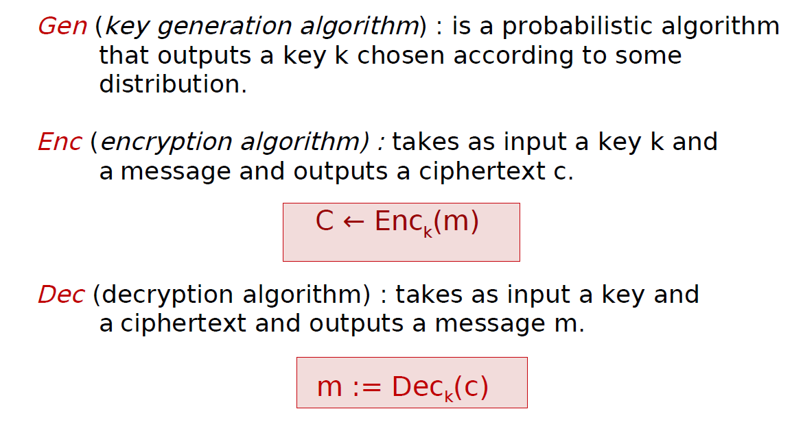
Cryptographic Algorithm
Any encrpytion scheme(Gen, Enc, Dec) is defined by three algorithms:

Slide 5
What is Security ?
Definition 1: An encryption scheme is secure if no adversary can find the secret key when given a cipher text.
Definition 2: An encryption scheme is secure if no adversary can find the plaintext that corresponds to the cipher text.
Definition 3: An encryption scheme i s secure if no adversary can determine any character of the plaintext that corresponds to the cipher text.
Definition 4: An encryption scheme is secure if no adversary can derive any meaningful information about the plaintext from the cipher text.

Slide 6
What is Security ?
Definition 5: An encryption scheme is secure if no adversary can compute any function of the plaintext from the cipher text.

Slide 7
Kerckhoffs’ Principles
Principle 1: The cipher method must not be required to be secret.
Principle 2: The adversary knows the algorithm.
Principle 3: The only secret is the key.

Slide 8
Perfect Secrecy
Perfect Secrecy: An encryption scheme (Gen, Enc , Dec) over a message space M is perfectly secret if for every probability distribution over M, every message m ∈ M, and every cipher text c ∈ C for which
Pr[C= c] >0:
Pr[M = m | C = c] = Pr[M= m]
Plaintext
Message Space
Key Space
Cipher Message Space
|M|
|K|
|C|
Thus, |M|=|K|=|C|

Slide 9
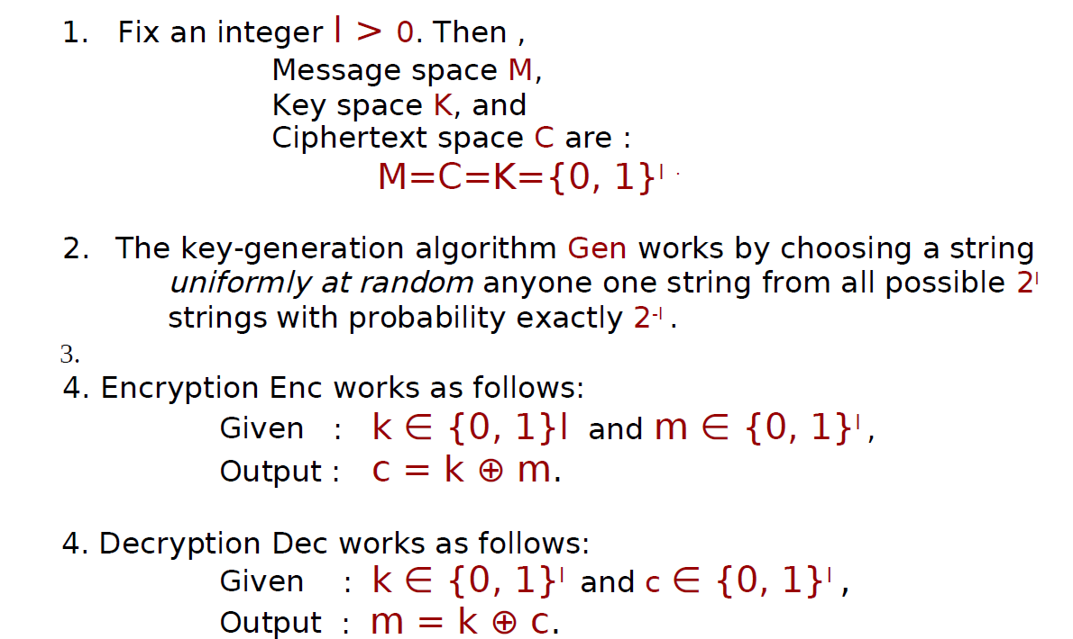
One Time Pad(Vernam’s Cipher)
The one time pad cipher is defined as follows:

Slide 10
Computational Secrecy
Basic idea of Computational Secrecy:
A cipher must be practically, if not mathematically, indecipherable.
Computational Security Relaxations Since, Perfect secrecy is too difficult to achieve. The computational approach uses two relaxations:
Security is only preserved against effcient adversaries, and
Adversaries can potentially succeed with some very small probability .

Slide 11
Stream Ciphers
Start with a secret key (“seed”)
Generate a keying stream
i-th bit/byte of keying stream is a function of the key and the first i-1 ciphertext bits.
Combine the stream with the plaintext to produce the ciphertext (typically by XOR)
Examples are
A5 – encrypting GSM handset to base station communication
RC-4 (Ron’s Code)

Slide 12
Example of Stream Encryption
Example of Stream Encryption/ Decryption
Key
Key
Stream
Stream
⊕
⊕
Plaintext
Ciphertext
=
=
Ciphertext
Plaintext

Slide 13
Block Ciphers
Encrypt a block of input to a block of output
Typically, the two blocks are of the same length
Most symmetric key systems block size is 64
In AES block size is 128
Different modes for encrypting plaintext longer than a block.
Examples include DES, 3-DES, AES, RC-2, RC-5, IDEA, Blowfish etc.

Slide 14
Block Ciphers
Modes of Operation :
✓ Electronic Codebook (ECB) Mode
✓ Cipher Block Chaining (CBC) Mode
✓ Cipher Feedback (CFB) Mode
✓ Output Feedback (OFB) Mode
✓ Counter (CTR) Mode

Slide 15
Introduction to Modern Cryptography
Symmetric Key Cryptography
Public Key Cryptography

Slide 16
Symmetric Key Cryptography Assumptions
The assumptions are :
The same key is use for both encryption and decryption and
the two communicants already share secret key, which somehow has
been distributed to them; or
the use of a key distribution center.
Problems:
key distribution – how to have secure communications in general
without having to trust a KDC with your key.
digital signatures – how to verify a message comes intact from the
claimed sender.

Slide 17
One-Way Functions

Slide 18

One-Way Functions
A one-way function is a function that is “easy” to compute
and “difficult” to reverse.
How might we express this notion of a one way
function informally in complexity theoretic terms?

Slide 19
OWF: Multiplying two primes (Integer Factorization)
Integer Factorization Problem(IFP) is given two numbers
u and v, finding their product n is easy but given n finding
u and v is hard.
Multiplication runs in polynomial time.
This poblem is believed to be a one-way
function.

Slide 20
OWF: Modular exponentiation (DLP)
Let G be a finite group of size n, assume that G is a multiplicative
cyclic group, and g is generator of G. Any element a in G can be
uniquely expressed as a = g^{x} for some integer x in the range
0 <= x <= n-1. The integer x is called as the discrete logarithm
or index of a with respect to g.
Computing x from G, g and a is called the discrete logarithm problem.

Slide 21
OWF: Modular exponentiation (DLP)
Modular exponentiation means computing a^{b} modulo some
other number n. We tend to write this as
a^{b} mod n.
Modular exponentiation is “easy”.
In other words, given a number a and a prime number n, the
function
f(b) = a^{b} mod n
is believed to be a one-way function.

Slide 22
OWF: Modular exponentiation (DLP)
However, given a, n, and a^{b} mod n (when n is prime), calculating
b is regarded by mathematicians as a hard problem.
This difficult problem is often referred to as the
Discrete Logarithm Problem (DLP).
In other words, given a number a and a prime number n, the
function
f(b) = a^{b} mod n
is believed to be a one-way function.

Slide 23
Introduction to
Public Key Cryptography

Slide 24
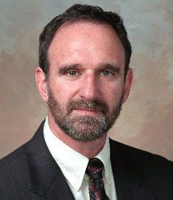
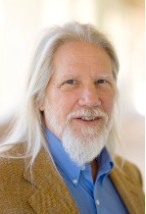
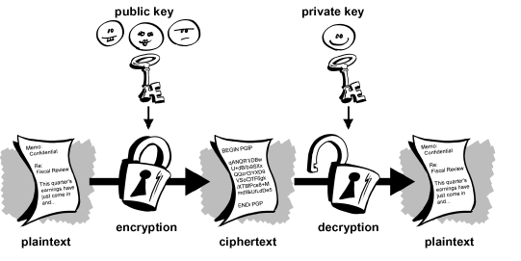
Public Key Cryptography
Whitfield Diffie & Martin Hellman
introduced the idea of Public Key
Cryptography at Stanford U.S. in
1976 .
Martin Hellman
Whitfield Diffie
Fig-2: Public Key Cryptography Concept

Slide 25
Public Key Cryptography
Public key blueprint
The keys used to encrypt and decrypt are different.
Anyone who wants to be a receiver needs to “publish” an
encryption key, which is known as the public key.
Anyone who wants to be a receiver needs a unique decryption
key, which is known as the private key.
Thus PKC has six ingredient
Plain text
Encryption algorithm
Public and private keys
Ciphertext
Decryption algorithm

Slide 26
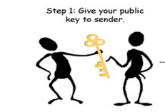
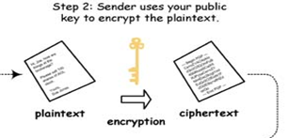
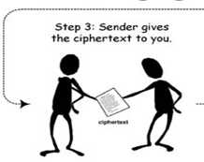
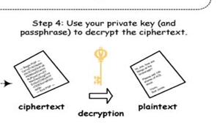
Public Key Cryptography
Fig-3: PKC procedure for Encryption and Decryption

Slide 27
Public Key Characteristics
Public-Key algorithms rely on two keys where:
it is computationally infeasible to find decryption key knowing
only algorithm & encryption key
it is computationally easy to en/decrypt messages when the
relevant (en/decrypt) key is known
either of the two related keys can be used for encryption, with
the other used for decryption (for some algorithms)

Slide 28
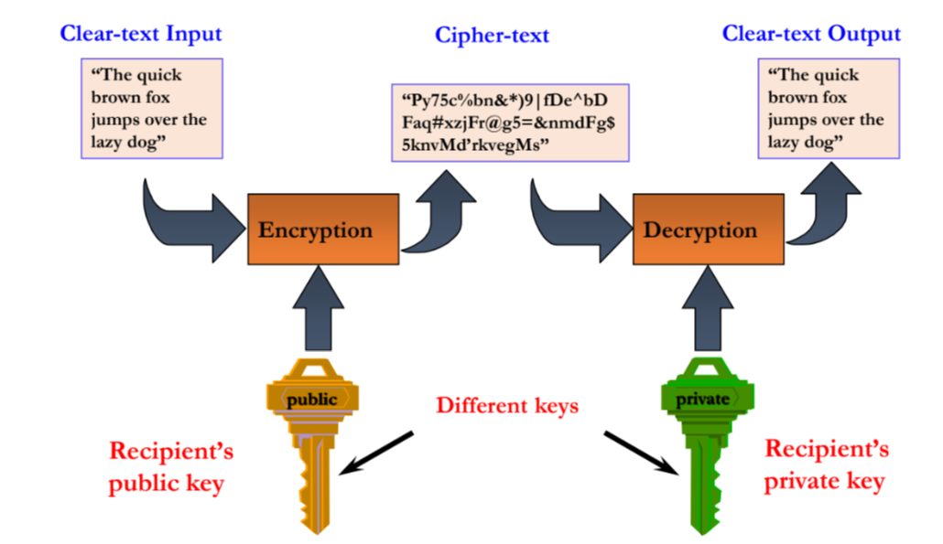
Public Key Cryptosystem

Slide 29
Public Key Cryptography Requirements
It is easy for party B to generate a pair of keys (public key PUb ,
Private key PRb).
It is easy for a sender A , knowing the public key and message to
be encrypt. C=E(PUb, M)
It is easy for receiver B to decrypt the resulting ciphertext using
the private key . M=D(PRb,C)=D[PRb,E(PUb,M)]
It is infeasible for an any person , to know the public key PUb to
determine the private key PRb.
It is infeasible for any person to know the public key PUb and a
ciphertext C to recover the original message M.
Two keys can be applied in either order
M=DP[PUb, E(PRb,M)] = D[PRb,E(PUb, M)]

Slide 30
Public Key Cryptography Applications
can classify uses into 3 categories:
encryption/decryption (provide secrecy)
digital signatures (provide authentication)
key exchange (of session keys)
some algorithms are suitable for all uses, others are specific to one

Slide 31
RSA Cryptosystem

Slide 32
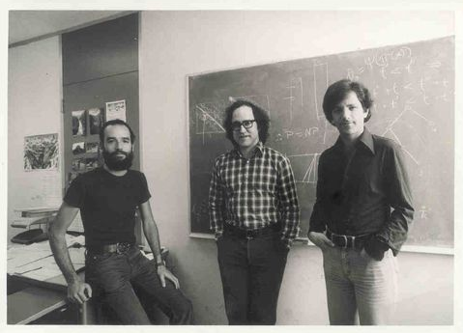
RSA Algorithm
Invented by Rivest, Shamir &
Adleman of MIT in 1977.
It is a best known & widely
used public-key scheme.
It is a block cipher algorithm
in which palintext and
ciphertext integers between 0
to n-1 for some n.
A typical size for n is 1024 bits
or 309 decimal digits.
Ron Rivest , Adi Shamir and Len Adleman (left to right)
Based on idea that . . . Factorization is difficult.

Slide 33
RSA Algorithm (Mathmetics Involved)
Let n be the product of two large primes p and q
By “large” we typically mean at least 512 bits.
Ф(n) = (p-1) x (q-1)
Select a special number e between 1 andФ(n).
Publish the pair of numbers (n , e)
Compute the private key d from p, q and e .

Slide 34
RSA Algorithm (Computing Private key)
The private key d is computed to be the unique inverse of
e modulo (p-1)(q-1).
In other words, d is the unique number less than (p-1)(q-1)
that when multiplied by e gives you 1 modulo (p-1)(q-1).
Written mathematically:
ed = 1 mod (p-1)(q-1)
The Euclidean Algorithm is the process that you need to
follow in order to compute d.

Slide 35
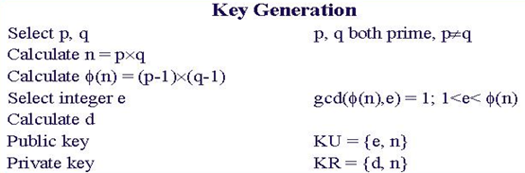


RSA Algorithm

Slide 36

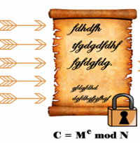
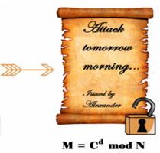
RSA Algorithm (Encryption)
Simplified model of RSA Cryptosystem

Slide 37
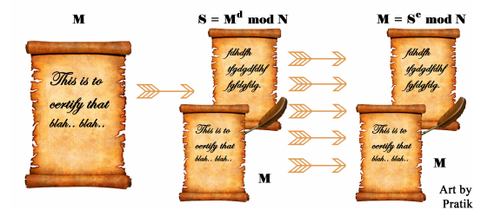
RSA Algorithm (Signature)
Simplified model of RSA Signature

Slide 38
RSA Algorithm Example
Step 1: Let p = 47 and q = 59. Thus n = 47 x 59 = 2773
Step 2: Select e = 17
Step 3: Publish (n,e) = (2773, 17)
Step 4: Ф(n) = (p-1) x (q-1) = 46 x 58 = 2668
Use the Euclidean Algorithm to compute the modular
inverse of 17 modulo 2668. The result is d = 157
<< Check: 17 x 157 = 2669 = 1(mod 2668) >>
Public key is (2773,17)
Private key is 157

Slide 39
RSA Algorithm Example Cont.
Public key is (2773,17)
Private key is 157
Plaintext block represented as a number: M = 31
Encryption using Public Key: C = 31¹⁷ (mod 2773)
= 587
Decryption using Private Key: M = 587¹⁵⁷ (mod 2773)
= 31

Slide 40
Diffie-Hellman Key Exchange

Slide 41
Diffie-Hellman Key Exchange
It is used by two users to securely exchange a key that can be
used for subsequent encryption of messages.
a public-key distribution scheme
cannot be used to exchange an arbitrary message
rather it can establish a common key
known only to the two participants
value of key depends on the participants (and their private and public
key information)
based on mathematical principles
security relies on the difficulty of computing discrete logarithms
(similar to factoring) – hard

Slide 42
Diffie-Hellman Key Exchange Algorithm
Global Public Elements
q = prime number(300 decimal, i.e. 1024 bits)
α = generator of field F_{q}
Let p=11 and α =2 then α^1 = α, α ^2=4, ..
User A key Generation
Select private X_{a} , X_{a} < q
Calculate public Y_{a} , Y_{a} = α ^{X}a mod q
User B Key Generation
Select private X_{b} , X_{b} < q
Calculate public Y_{b} , Y_{b} = α ^{X}b mod q

Slide 43
Diffie-Hellman Key Exchange Algorithm
Generation of secret key by user A
K=(Y _{b}) ^{X} a mod q
Generation of secret key by user B
K=(Y _{a}) ^{X} b mod q

Slide 44
Key Exchange Example
users Alice & Bob who wish to swap keys:
agree on prime q=353 and α=3
select random secret keys:
A chooses x_{A}=97, B chooses x_{B}=233
compute respective public keys:
y_{A}=397 mod 353 = 40 (Alice)
y_{B}=3233 mod 353 = 248 (Bob)
compute shared session key as:
K_{AB}= y_{B} ^{x}A mod 353 = 24897 = 160 (Alice)
K_{AB}= y_{A} ^{x}B mod 353 = 40233 = 160 (Bob)

Slide 45
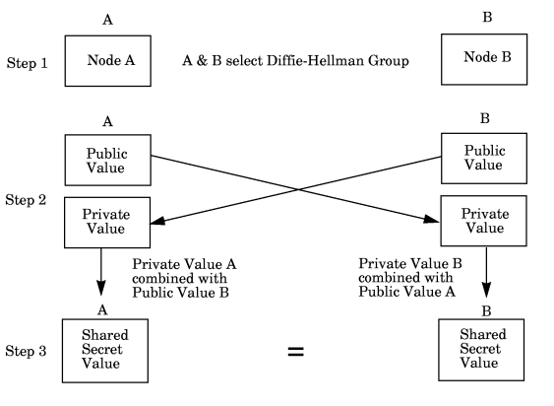
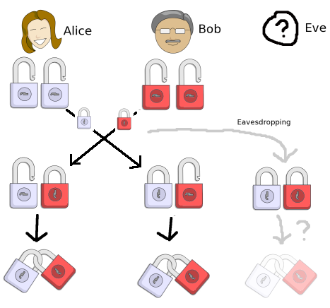
Diffie-Hellman Key Exchange
Fig-1 : Diffie-Hellman Key-Exchange Procedure

Slide 46
ElGamal Cryptosystem

Slide 47
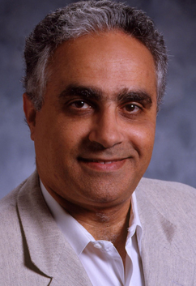
ElGamal Cryptosystem
El_Gamal is a public-key cryptosystem technique
was designed by Dr. Taher Elgamal .
Key aspects:
Based on Discrete Logarithm Problem,
Randomized Encryption
Applications :
Key sharing
Encrypting messages.
Taher ElGamal

Slide 48
ElGamal Algorithm
Let p be a large prime
By “large” we mean here a prime rather typical in length to that
of an RSA modulus .
Choose g(α)
The number g must be a primitive element modulo p.
Choose a private key x
This can be any number between 1 and p-1
Compute public key y from x, p and g
The public key y is g raised to the power of the private key x
modulo p. In other words:
y = g ^{x} mod p

Slide 49
ElGamal Algorithm : Example
Step 1: Let p = 23
Step 2: Select a primitive element g = 11
Step 3: Choose a private key x = 6
Step 4: Compute y = 11⁶ (mod 23)
= 9
Public key is 9
Private key is 6

Slide 50
ElGamal Encryption
The first job is to represent the plaintext as a series of numbers
modulo p. Then:
Generate a random number k
Compute two values C₁ and C₂, where
C₁ = g ^{k} mod p and C₂ = M . y ^{k} mod p
Send the ciphertext C, which consists of the two separate values
C₁ and C₂.

Slide 51
ElGamal Encryption: Example
To encrypt M = 10 using Public key 9
1 - Generate a random number k = 3
2 - Compute C₁= 11³ mod 23 = 20
C₂= 10 x 9³ mod 23
= 10 x 16 = 160 mod 23 = 22
3 - Ciphertext C = (20 , 22 )

Slide 52
ElGamal Decryption
C₁ = g ^{k} mod p C₂ = M . y ^{k} mod p
1 - The receiver begins by using their private key x to transform
C₁ into something more useful:
C₁^{x} = (g ^{k} ) ^{x} mod p
NOTE: C₁^{x} = (g ^{k}) ^{x} = (g ^{x}) ^{k} = (y) ^{k} = y ^{k} mod p
2 - This is a very useful quantity because if you divide C₂ by it you
get M. In other words:
C₂ / y ^{k} = (M . y ^{k}) / y ^{k} = M mod p

Slide 53
ElGamal Decryption : Example
To decrypt C = (20 , 22 )
1 - Compute 20⁶ = 16 mod 23
2 - Compute 22 / 16 = 10 mod 23
3 - Plaintext = 10

Slide 54
Hash Functions

Slide 55
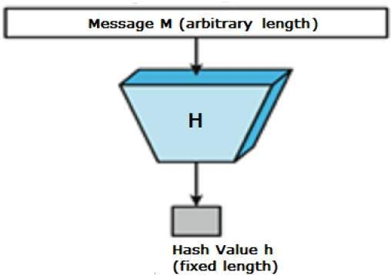
Cryptographic Hash Function
Cryptographic Hash functions is mainly used for Data Integrity
And Authentication.
A hash function takes a variable sized input message and
produces a fixed-sized output.
The output is usually referred to as the Hash Code or The
Hash Value or The Message Digest.

Slide 56
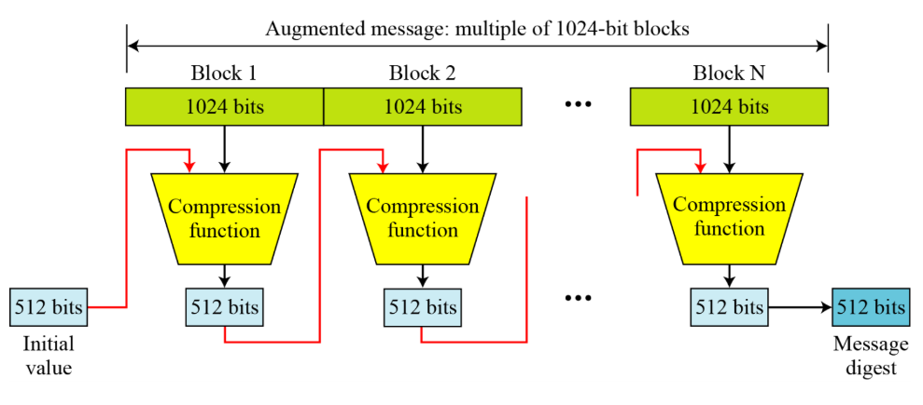
Hash Function - SHA 512

Slide 57
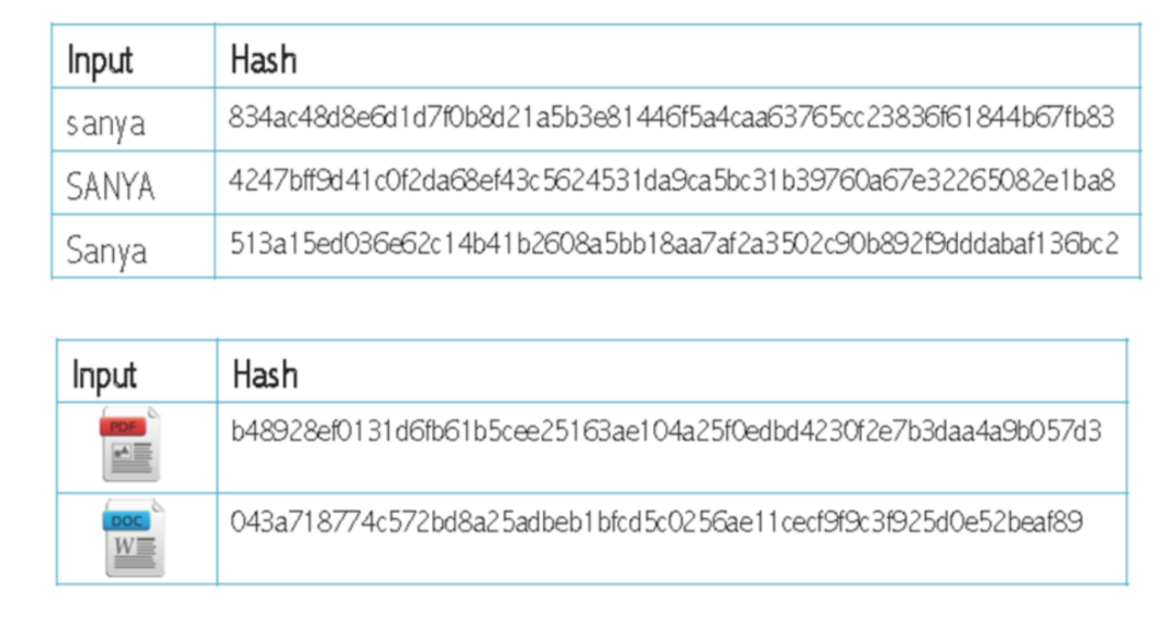
Hash Function - Example

Slide 58
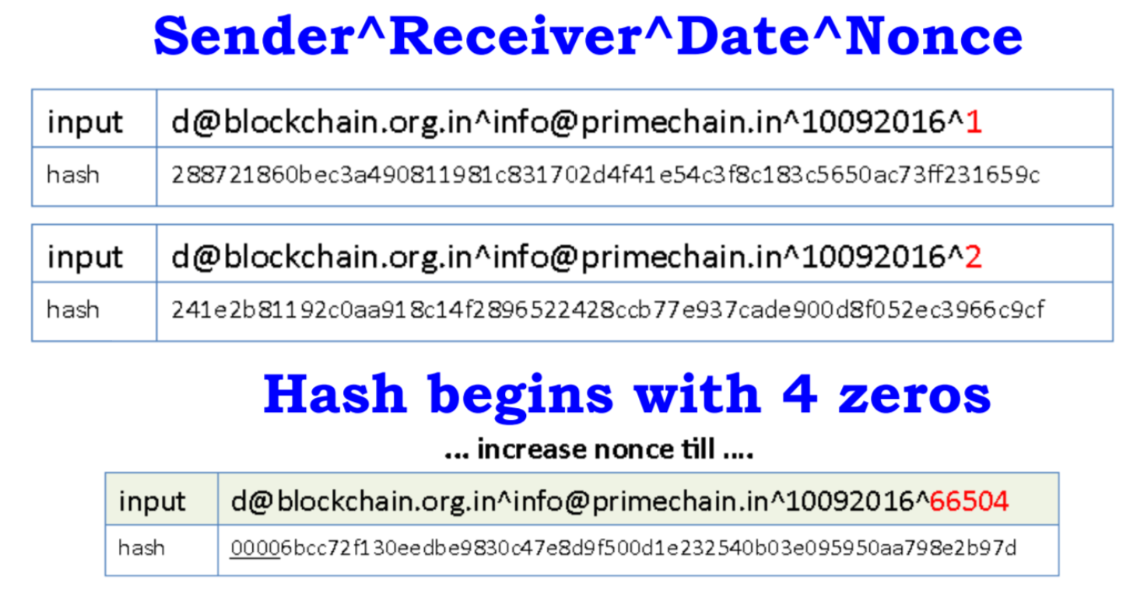
Hash Function - Example

Slide 59
Digital Signature

Slide 60
Digital Signature
Encryption, message authentication and digital signatures are all
tools of modern cryptography.
A signature is a technique for non-repudiation based on the public
key cryptography.
The creator of a message can attach a code, the signature, which
guarantees the source and integrity of the message.

Slide 61
Properties Of Digital Signature
Similar to handwritten signatures, digital signatures must fulfill
the following:
Recipients must be able to verify them
Signers must not be able to repudiate them later

Slide 62
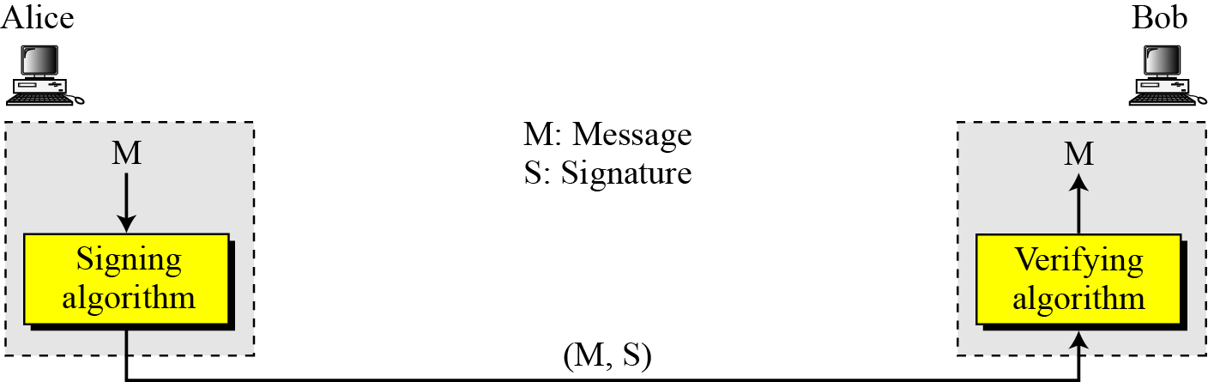
Digital Signature
Signing
Algorithm
Verifying
Algorithm
Fig-4 : Digital Signature Overview

Slide 63
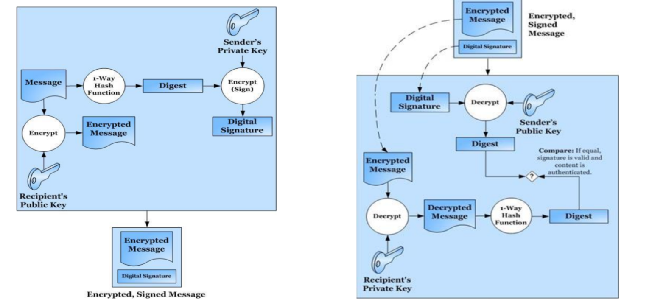
Digital Signature

Slide 64
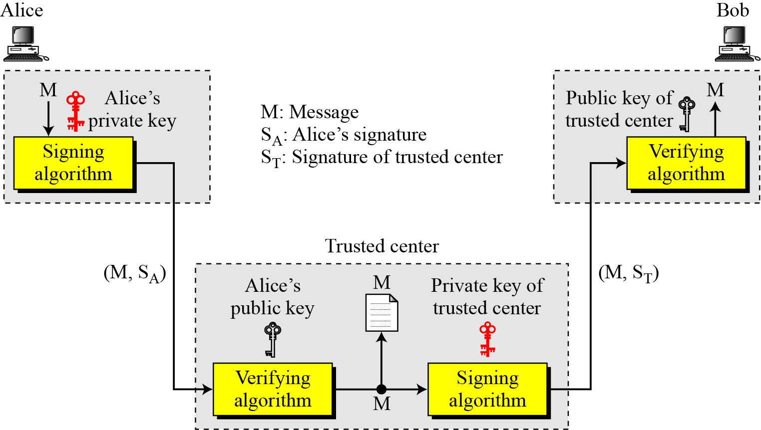
Digital Signature with Trusted Third Party
Signing
Algorithm
Verifying
Algorithm
Verifying
Algorithm
Signing
Algorithm
Fig-7 : Digital Signature by Trusted Third Party

Slide 65
Digital Signature Algorithm
Global Public-Key Components
p = A prime number of L bits where L is a multiple of 64 and 512 ≤ L ≤ 1024
q = A prime divisor of( p-1)
g = h^{(p-1)/q} mod p, where h is any integer with 1<h< p-1, such that (h^{(p-1)/q} mod p)>1
User’s Private Key
x = Choose x s.t. 0<x<q
User’s Public Key
y = g^{x} mod p
User’s Per-Message Secret Number
K = Choose K s.t. 0<k<q
Signing
r = (g^{k} mod p) mod q s = [k⁻¹ (H(M) + xr)] mod q
Signature = (r, s)
Verifying
w = (s’)⁻¹ mod q u₁ = [H(M’)w] mod q u₂ = (r’)w mod q
v = [(g^{u1}y^{u2}) mod p] mod q
Test: v = r’

Slide 66
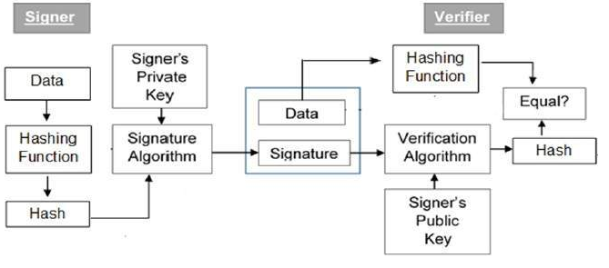
Digital Signature Algorithm
Fig-8 :DSS Approach

Slide 67
Alice Side : To sign a message, M:
1. Alice chooses primes p and q.
p = A prime number of L bits where L is a multiple of 64 and 512 ≤ L ≤ 1024
q = A prime divisor of( p-1)
Example : ✓ q = 5 ✓ P = 11
2. Alice uses <Zp*, × > and <Zq*, ×>.

Slide 68
Alice Side : To sign a message, M:
3. Alice genertaes the generator
g = h^{(p-1)/q} mod p, where h is any integer with 1<h< p-1, such that (h^{(p-1)/q} %p)>1
g = 3
4. Alice chooses private key x where 0<x<q.
x = 2
5. Alice Calculates the public key as
y = g^{x} mod q
y = 3² mod 11 = 9 mod 11 = 9

Slide 69
Alice Side : To sign a message, M:
6. Alice’s public key is (g, y, p, q); her private key is (x). Pub = (3,9,11,5) , Priv = (2)
7. Alice generates a random secret number , ‘K’, less than q. K = 2
8. Calculate message digest H(M) = 4
9. Alice generates Signature = (r, s) = (4,1)
r = (g^{k} mod p) mod q = (3² mod 11) mod 5 = 4
s = [ k⁻¹ (H(M) + xr) ] mod q = 3 (4 +2*4) mod 5
= 36 mod 5 = 1
k⁻¹ ⁼ 2⁻¹ mod 5 = 3 [2 * 3 mod 5 = 1]

Slide 70
Bob Sides : Verification
(g, y, p, q) = (3,9,11,5) , (r, s) = (4,1) H(M) = 4
1. Bob verifies the signature by computing
w = (s)⁻¹ mod q = 1 mod 5 = 1
u₁ = [H(M)w] mod q = 4 * 1 mod 5 = 4
u₂ = (r)w mod q = 4 * 1 mod 5 = 4
v = [(g^{u1}y^{u2}) mod p] mod q
= [(3⁴.9⁴) % 11] % 5 = ((81.6561) %11) %5
= 9 mod 5 = 4
Test: v = r’
2. The signature is verifies if v = r’ . 4 = 4

Slide 71

Any Queries ?

Slide 72
Thank You…

